Slide 1
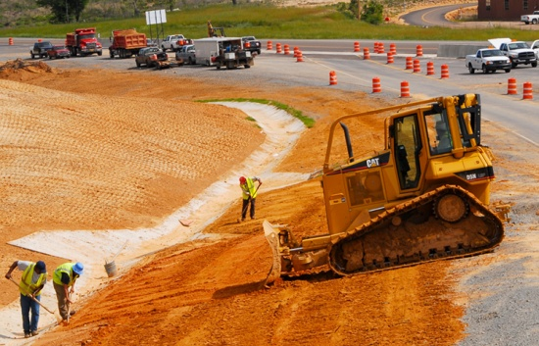
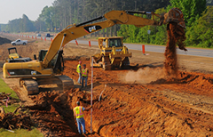
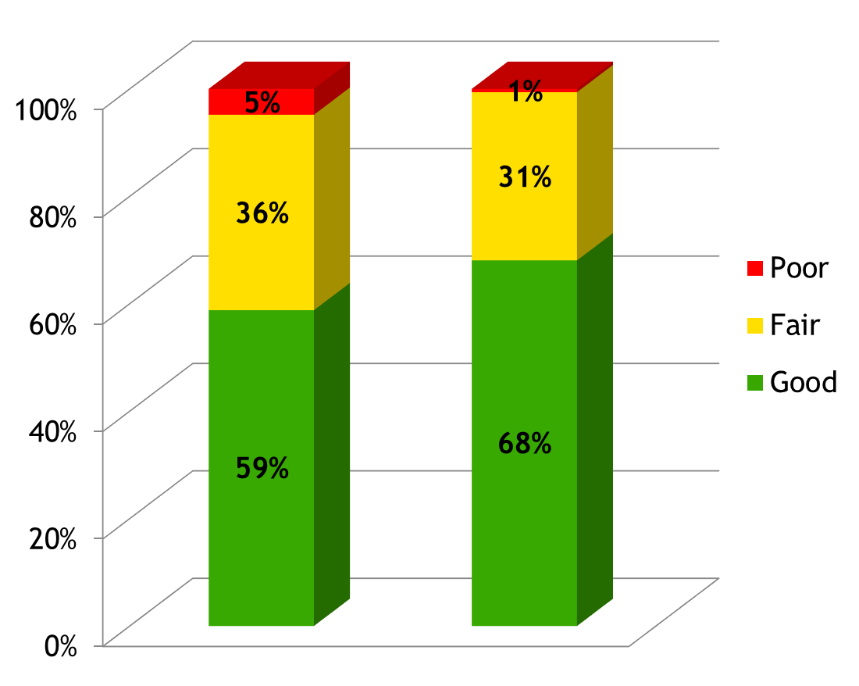
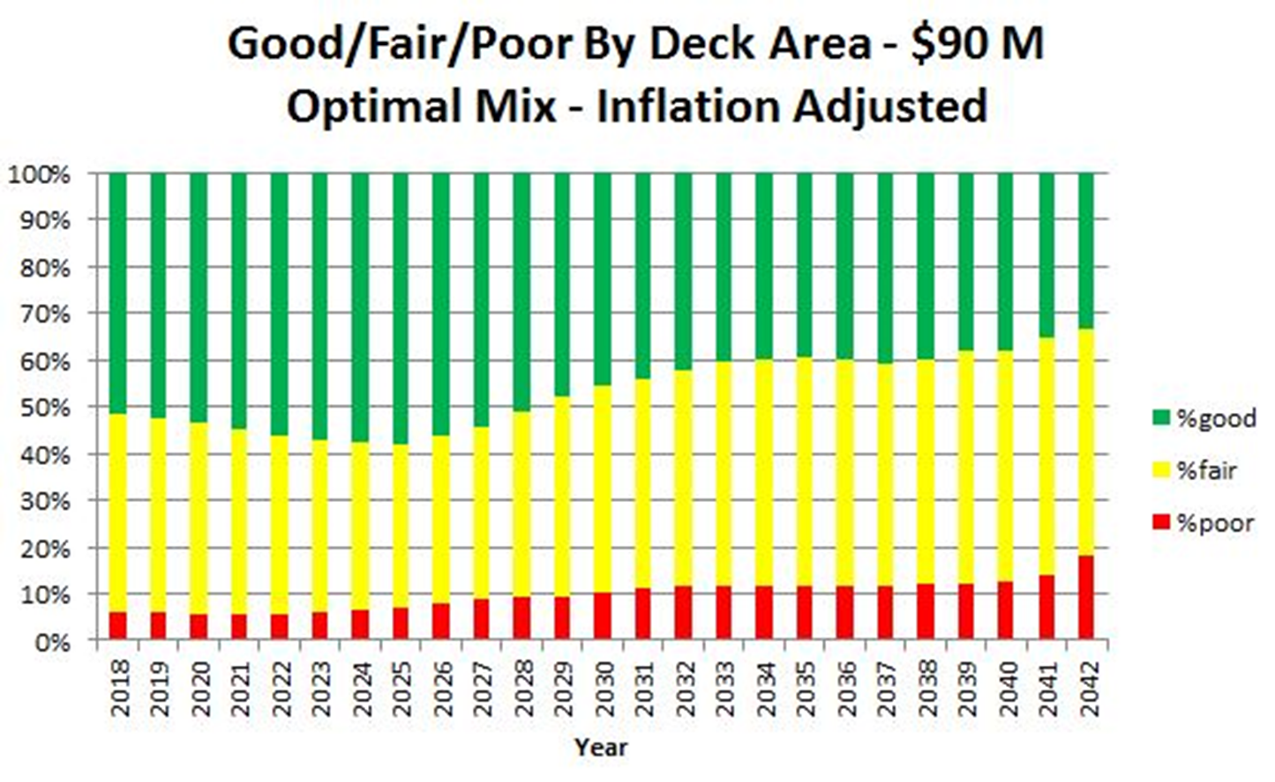
Enhancing Transportation System Performance
August 16, 2019
Brad McCaleb, P.E.
Division Engineer -
System Information & Research
Notes:
Think back for a moment about the year 2012. Were you in college, married, working in a different job?

Slide 2
The Year is 2012
RIVERFRON TIMES Dan Moore August 31, 2012
Best Sports Photos.com SKU37060
Best Sports Photos.com SKU12563
By MasterMind5991 - Own work, CC BY-SA 4.0, https://en.wikipedia.org/w/index.php?curid=60042732
Notes:
In 2012, the Giants won the Super Bowl and the World Series,
“We Are Never Ever Getting Back Together” by Taylor Swift and
“One More Night” by Maroon 5 were two of the top songs.
And most importantly for our purposes MAP-21 (Moving Ahead for Progress in the 21st Century) created the National Highway Performance Program.
By the way: The San Francisco Giants were originally from New York.

Slide 3
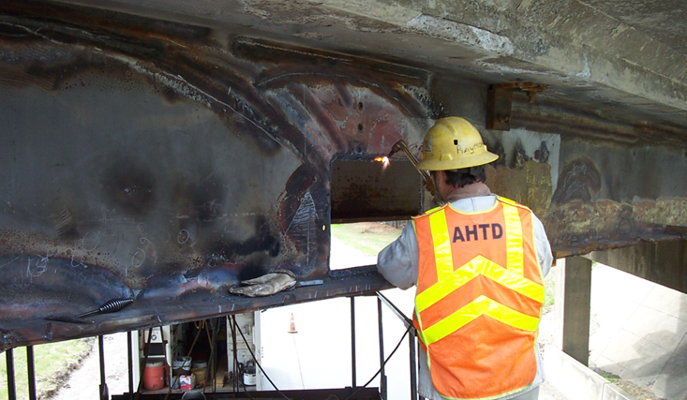
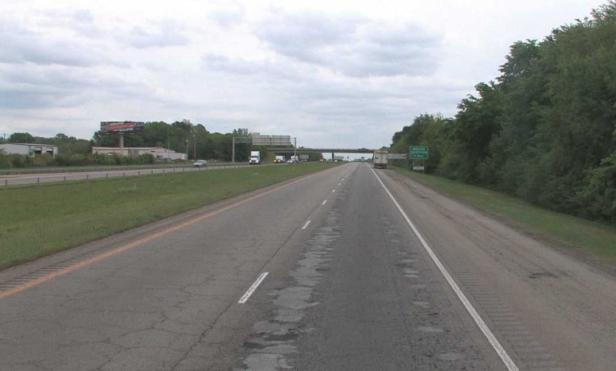
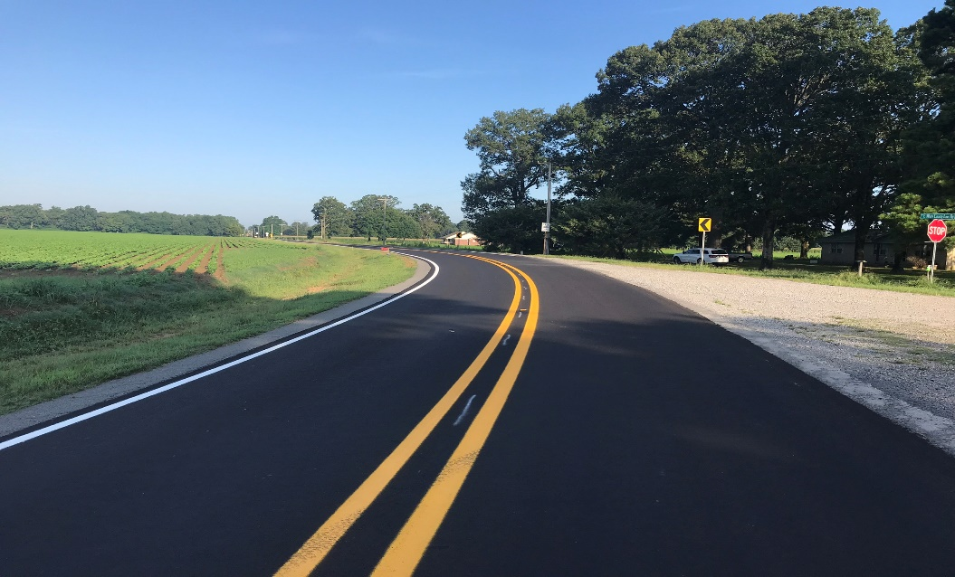
Federal Performance Based Requirements
Notes:
Transportation Performance Management continued with the FAST-ACT and included Federal Performance Requirements for pavements and bridges on the National Highway System (NHS)
The NHS includes all Interstates, most principle arterials and other select routes. For Pavements we are only looking at mainline through lanes. Bridges include all bridge class structures, including on- and off-ramps connecting to NHS routes and bridges across State borders.
Federal requirements include the Five & Dime Penalty Clause which means we can’t have more than 5% of Interstate Pavements or more than 10% of the total deck area of Structurally Deficient Bridges on the NHS in Poor Condition.
If we do not meet the pavement standard we lose flexibility on our National Highway Preservation Program (NHPP) and Surface Transportation Program (STP) funds. If we miss the requirements for bridges for 3 consecutive years we must set aside and obligate NHPP funds for NHS eligible bridge projects

Slide 4
Data Collection & Reporting Cycle
Fugro-Roadware – Pavement Data Collection Vehicle
Arkansas Highways - Mississippi River Bridge Inspection
Notes:
Pavement data is collected using a Pavement Condition Data Collection Vehicle.
We are required to collect Interstates in the outside lane in both directions on the entire system annually and
Non-Interstate NHS pavements are collected in the outside lane in one direction for undivided sections and both directions on divided sections every 2 years
The condition data is reported every year as part of our Highway Performance Monitoring System (HPMS) report.
Condition data for bridges and bridge-class culverts is collected on-site using Inspecttech software loaded on tablets.
Bridge are inspected every 2 years with some structures being inspected more frequently.
The data is reported annually to the National Bridge Inventory and as part of the HPMS.

Slide 5
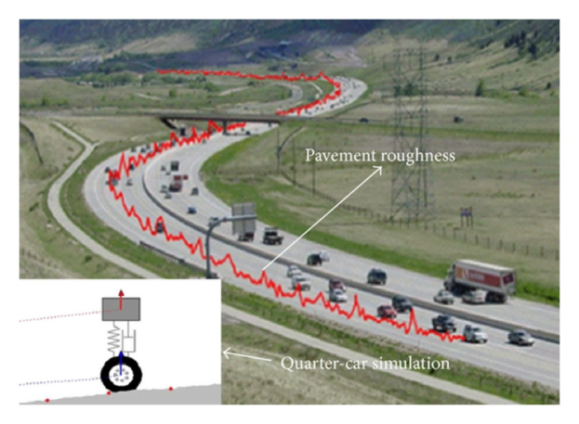
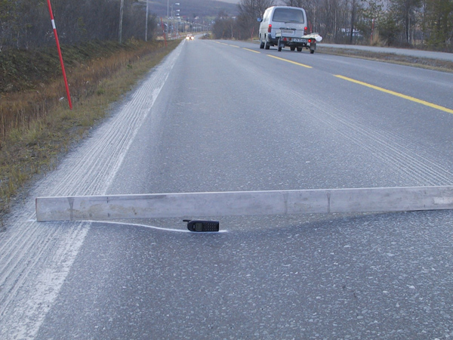
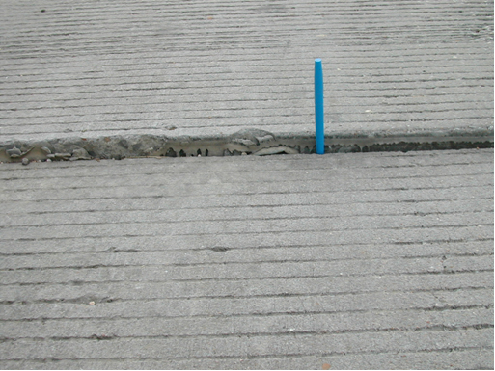
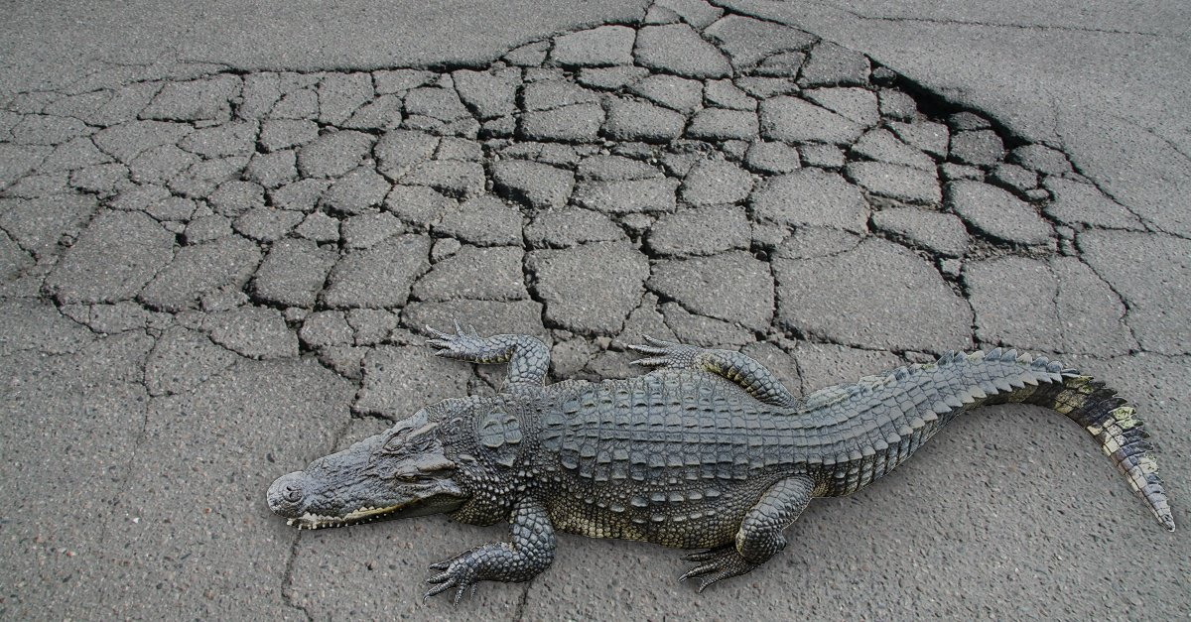
Pavement Related Data
researchgate.net: publication 258391356
roadex.org Rutting Example: 34_3c.jpg
txdot.gov: 10_servere_fault_transverse_joint.jpg
wolfpaving.com: WOLF_Social_ Alligator-2.jpg
Notes:
The Pavement Related Data we are required to collect includes:
International Roughness Index (IRI)
Rutting
Faulting
Cracking
Macro Texture
Geometrics (Curve, Grade, Crossfall, Super-elevation)
Geographic Location and
Roadway Features

Slide 6
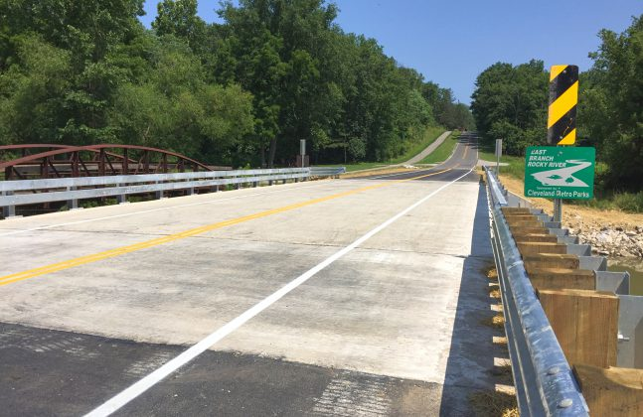
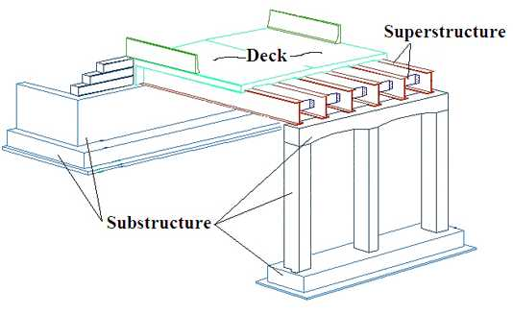
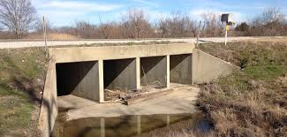
Bridge Related Data
AllThingsFibers.com – FRC Applications Series
Michigan DOT Bridge Structural Elements Diagram
≥ 7 = G
5/6 = F
<5 = P
Hayden Consultants – Bridge-class Culvert
Arkansas Highways: I-40 White River Bridge Construction
Notes:
Bridge data is collected in accordance with the National Bridge Inspection Standards (NBIS) for the three structural elements:
Deck
Superstructure; and
Substructure
The overall condition of a bridge is determined by the lowest graded structural element while culverts are graded as a single unit.
A rating of 7 or greater is Good, a rating of 5 or 6 is Fair and a rating less than 5 is Poor.

Slide 7
ARDOT Pavement Condition Rating
$$PCI=(Wt){IRI}_{100}+(Wt){RUT}_{100}+(Wt){WCX}_{100}$$
100 to 85 = A
Federal Requirements
 | Asphalt and JCP | CRCP
Overall Section Condition Rating | 3 metrics ratings (IRI, cracking, and rutting/faulting) | 2 metrics ratings (IRI and cracking) |  | Measures
Good | All 3 metrics rated “Good” | Both metrics rated “Good” |  | Percentage of lane miles in “Good” Condition
Poor | ≥ 2 metrics rated “Poor” | Both metrics rated “Poor” |  | Percentage of lane miles in “Poor” Condition
Fair | All Other Combinations | All Other Combinations
<85 to 70 = B
<70 to 55 = C
<55 to 40 = D
≤ 40 = F
Notes:
We use the Pavement Condition Index as a summary measure for our pavement conditions
The PCI represents the general condition of a pavement section on a scale of 0 to 100.
The PCI is calculated as the weighted average of four metrics: roughness, rutting or faulting, and environmental and structural cracking.
The PCI score is then used to assign a letter grade of A thru F based on the scale shown.
To comply with federal requirements we have to report our PCI grade using the Federal Good, Fair, Poor scale for each 1/10 mile pavement section
As you can see the Federal conditions are simply based on an equal weighting of the metrics and all metrics must be in Good condition for the overall section to be Good. If two or more metrics are rated Poor the whole section is rated Poor and any other combination is rated as Fair.
The biggest issue with the Federal grading is that cracking has a greater impact on pavement condition than the Federal criteria reveals.
NEXT SLIDE

Slide 8
ARDOT vs. Federal Condition Rating
Notes:
This slide shows the difference between the federal condition ratings of G/F/P and our PCI grades.
The bar chart on the right shows our internal PCI. This is the pavement condition rating we base treatment recommendations on.
The chart in the middle shows the pavement condition using G/F/P ratings based on our Internal PCI where A+B=Good, C+D=Fair, F=Poor
The bar chart on the left labeled Federal is the pavement condition based on the Federal Good, Fair, Poor criteria for the individual metrics. Comparing our G/F/P results to the Federal G/F/P results shows that the methodologies do not align.
NEXT SLIDE

Slide 9
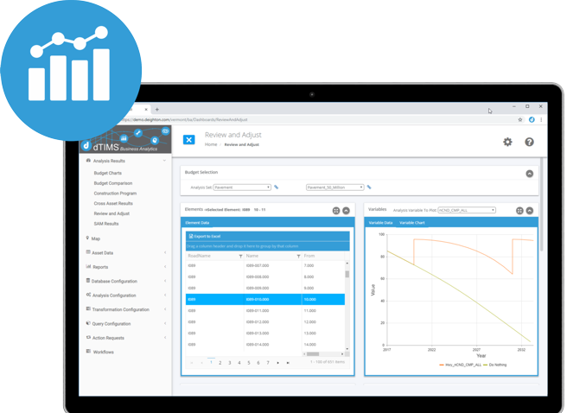
Data Analysis Platform
Notes:
The Deighton Transportation Information Management System or dTIMS is the platform used for both the Bridge Management System and the Pavement Management System.

Slide 10
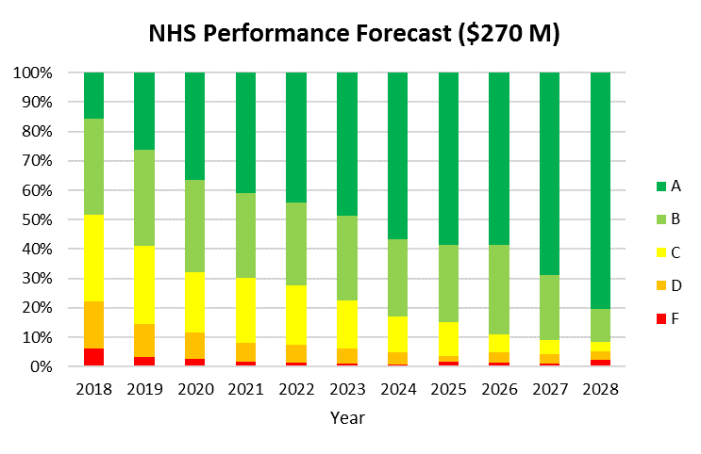
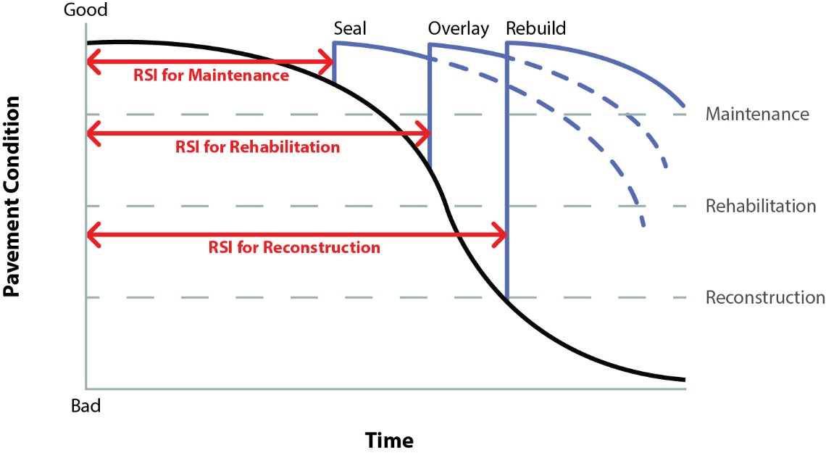
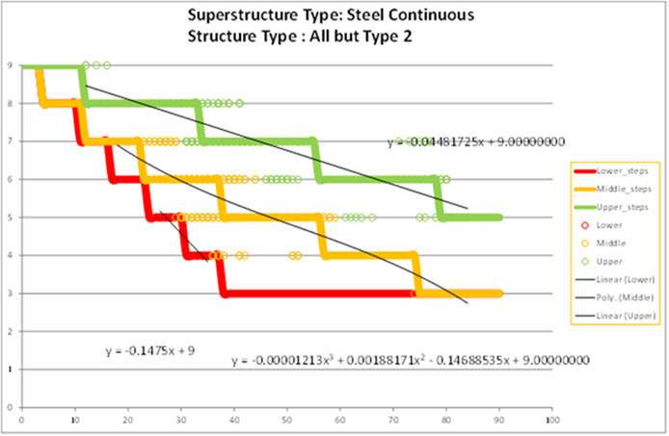
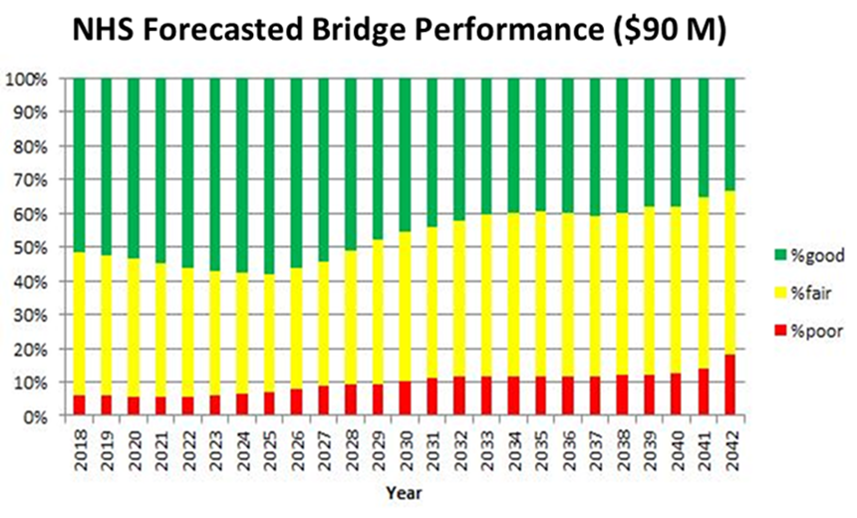
Deterioration Curves and Condition Forecasting
Pavement Condition Index
Maintenance
Rehabilitation
Reconstruction
Time
Notes:
dTIMS allows us to analyze the life-cycle performance of our pavements and bridges and determine appropriate types of treatment and the timing for those treatments using the deterioration curves shown on the left.
We can also develop forecasts for individual assets or a group of assets at any system level including the statewide network.
The bar graphs on the right show forecasts of overall performance system-wide at a given funding level.

Slide 11
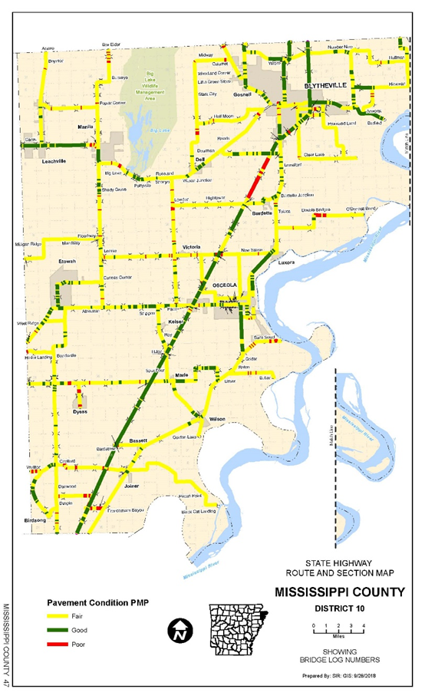
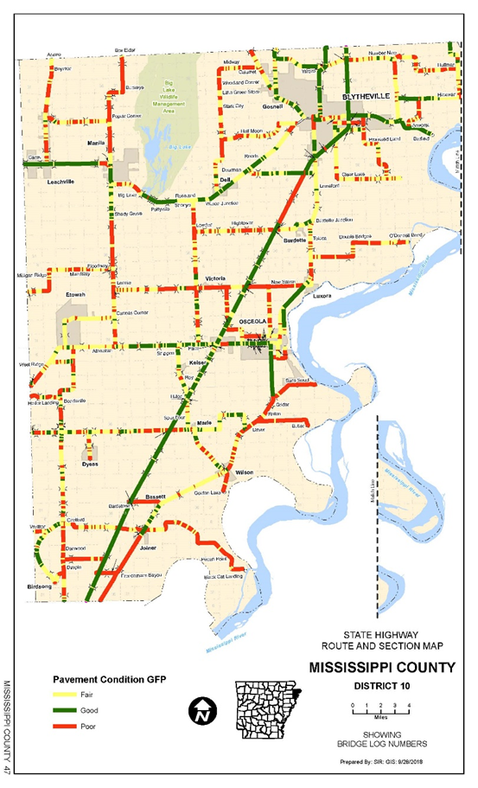
Applications in Project Programming
Pavement Condition Map
Notes:
These maps are an example of the Pavement Condition Maps that can be created and they show the difference between the Federal Condition Ratings and our Pavement Condition Ratings.
The Bridge and Pavement condition information is used in several project level decisions including:
Identifying Potential STIP Projects
Ensuring compliance with the Preventive Maintenance Agreement between the Department and FHWA
District and Statewide maintenance activities
Identification of Pavement Preservation Projects, and
Scoping of pavement and bridge projects

Slide 12
ARKANSAS DEPARTMENT OF TRANSPORTATION
ARDOT.gov
IDriveArkansas.com
ConnectingArkansasProgram.com
InterstateRehabilitationProgram.com
Vimeo.com/myARDOT
@myARDOT
Notes:
That concludes my presentation.

